Slide 1
EDUARDO DA SILVA
Mateja Šebalj

Slide 2
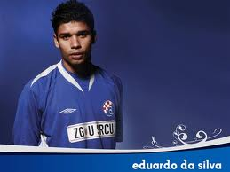
about him:
Eduardo da Silva was born on February 25, 1983rd in Rio de Janiero.
He is also known as Dudu.

Slide 3
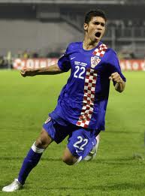
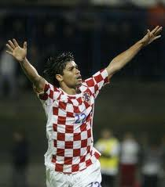
Football:
Eduardo is a Brazilian-Croatian footballer.
Previously he played for Brazil's New Kennedy, Inter-Zagreb, Dinamo Zagreb and London's Arsenal.

Slide 4
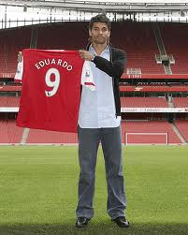
Career:
Eduardo started his career in his native Brazil, in the club New Kennedy.
As a fifteen year old spotted by scouts as Dinamo Zagreb, and he moved to the juniors of the club.

Slide 5
ARSENAL:
On 2 July 2007. confirmed to be transferred to the English football giants Arsenal, who signed for four years.
In the preparatory period, the Amsterdam Tournament against Lazio Roman scored his first goal for his new club, and return match 3 Champions League qualifying round against Sparta Prague and gave his debut in official matches.

Slide 6
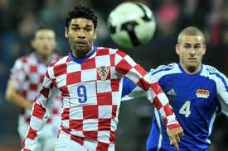
National team:
In 2002. Eduardo took Croatian nationality.
After missed the World Cup in Germany, under the new coach Slaven Bilic Eduardo came to the place of the first 11.
Against Russia in Moscow, played his first competitive match in the Croatian jersey.

Slide 7
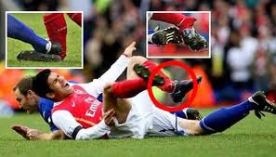
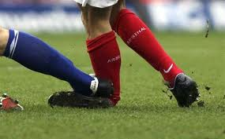
Injury:
Eduardo suffered a serious ankle injury in the match with Birmingham, it was attacked Martin Taylor, who immediately got a red card
. Eduardo suffered an open fracture of the fibula, or outer bone on his left leg after which he immediately underwent surgery in Birmingham hospital.

Slide 8
