Slide 1
John Lennon
Antonija Vuković 7.b
Jelena Hodak 7.b

Slide 2
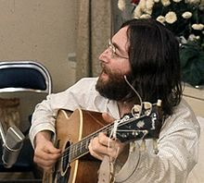
John Winston Ono Lennon was born in Liverpool 9. October 1940.

Slide 3
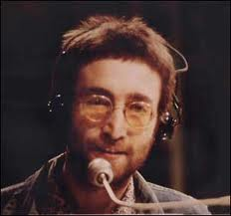
Childhood
Father Fred Lennon was absent from home.
The father returned the family five years later, but his wife Julia did not want to live with it.

Slide 4
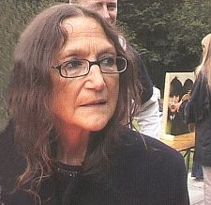
His mother died 1958. in a car accident in front of the house damage, when John was seventeen years.

Slide 5
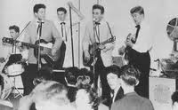
The Beatles
1995. founded his first group The Quarrymen, s prijateljem Peteom Shottonom.
Other members were Nigel Walley und Ivan Vaughan.

Slide 6
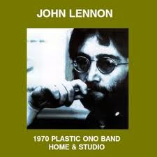
Solo Albums
Even before the dissolution of the group recorded three experimental albums with his second wife Yoko Ono. His most successful album John Lennon / Plastic Ono Band in 1970. Imagine, 1971.

Slide 7
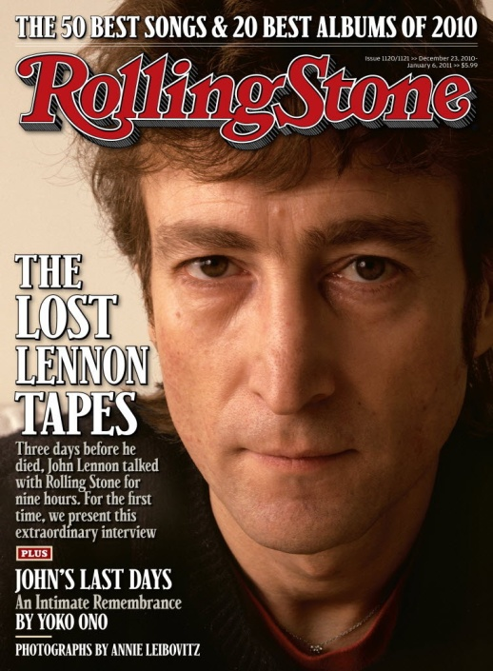
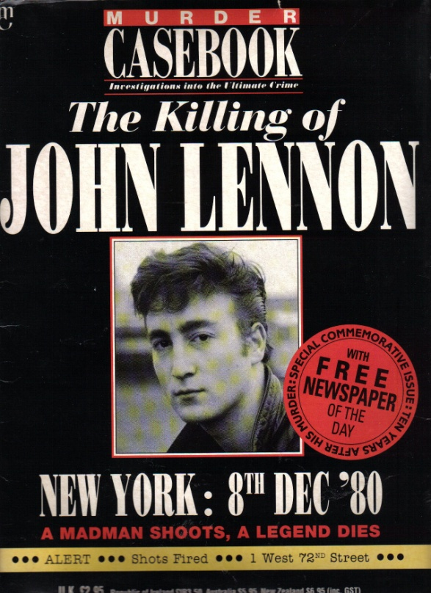
Murder
He was killed 8. October 1980. years, shot dead by Mark David Chapman in front of the Dakota building in New York.

Slide 8
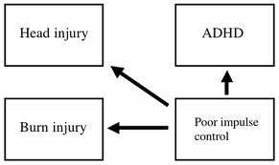
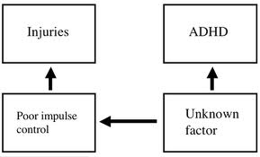
ADHD

