Slide 1
IVANO BALIĆ
MATIJA ŠPEHAR AND IVAN VUKOVIĆ

Slide 2
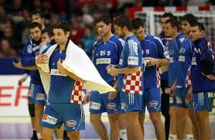
Ivano and team
Ivano is a very good shooter and often score a goal.
Ivano is not very young but plays well in good shape.
When Ivano plays he doesn’t aim to win, but to play very good.
Ivano is proud of himself and other players from his team.

Slide 3
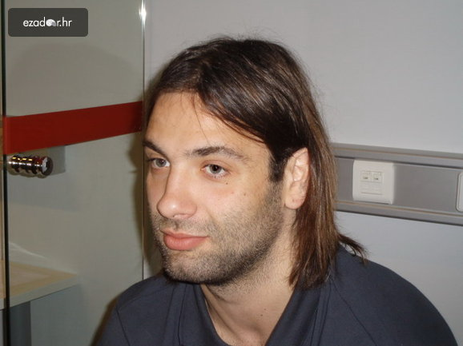
HANDBALL
He won a gold medal at the Mediterranean Games 2001 th in Tunisia. World Champion 2003rd in Portugal. He is winner of a gold medal at the 2004th Olympic Games in Athens.

Slide 4
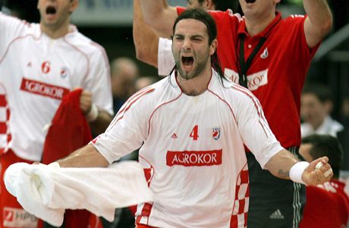
BEST PLAYER

Slide 5
CLUB CARRER
Before rugby for many years, he led the basketball team then Jugoslavija and POP 84, today's KK Split, which is obviously influenced his unusual solutions and creativity in the game. Handball has begin to play in the RK "Split". After three years of affirmations (2001 to 2004.) In RK Metković, Balić 2004th for four years, moved to Portland San Antonio.

Slide 6
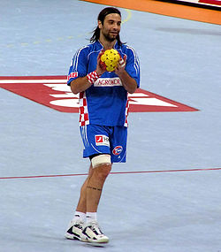
CRAZY FOR HANDBALL
-Ivano Balić likes handball.
-Ivano Balić have strong shoot.
-Ivano balić played for the Croatian national team.
-Ivano Balić is very good player.

Slide 7
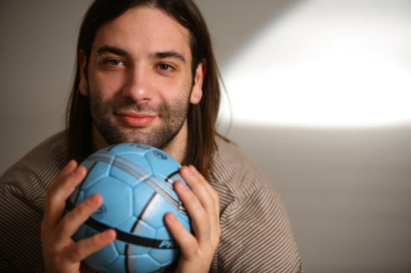
HANDABALL IS HIS LIFE

Slide 8
ALL PLAYERS
Mirko Alilović Blaženko Lacković
Goran Čarapina Tonči Valčić
Marin Šego Jakov Gojun
Manuel Štrlek Drago Vuković
Vedran Mataija Damir Bičanić
Vedran Zrnić Ivano Balić
Ivan Čupić Domagoj Duvnjak
Igor Vori Denis Buntić
Željko Musa Marko Kopljar

Slide 9
THE END :D
THE END

