Slide 1
OŠ Eugena Kvaternika Rakovica The Beatles
Student: Jelena Hodak 7.b
Teacher: Snježana Oštrina Panić

Slide 2
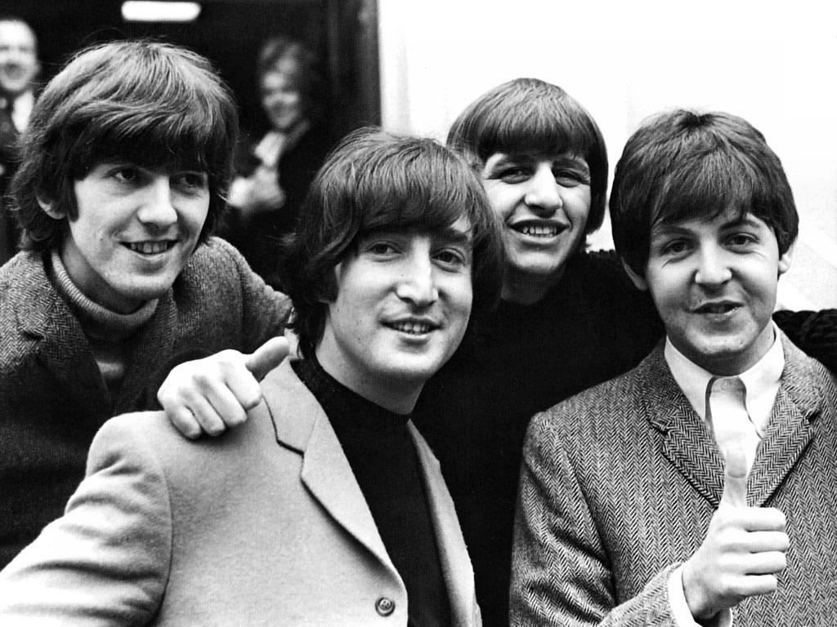
Members of the Betlasa
Members of the Beatles were John Lennon, Paul McCartney, George Harrison and Ringo Starr.

Slide 3
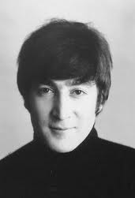
John Lennon
John Lennon was born in Liverpool on 9th October 1940
His mother died in 1958 in a car accident when John was seventeen years

Slide 4
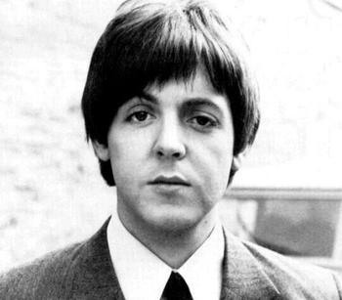
Paul MaCartney
born in Liverpool on 18th June 1942
it is located in the Guinness Book of Records

Slide 5
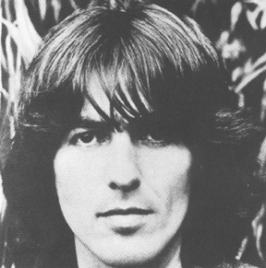
George Harrison
He was born in Liverpool, on 25th February 1943.
Harrison was the Beatles who played the solo guitar

Slide 6
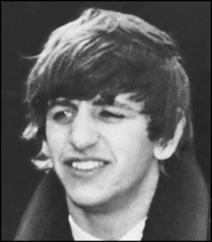
Ringo Starr
born on 7th July 1940. in Liverpool
With six years he had appendicitis, which are complications caused by ten-coma, so the hospital kept him for one year.

Slide 7
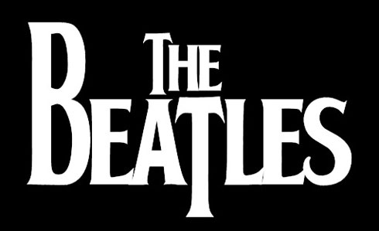
In their native United Kingdom during 1962–1970, The Beatles released 12 studio albums, 13 EPs, and 22 singles.

Slide 8
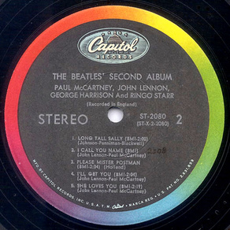
Beatles songs
Please Please Me is the second single records released by the Beatles in Britain, and their first record was released in America.
In January 1964th song "I Want To Hold Your Hand " overdue at the top of American music charts.

Slide 9
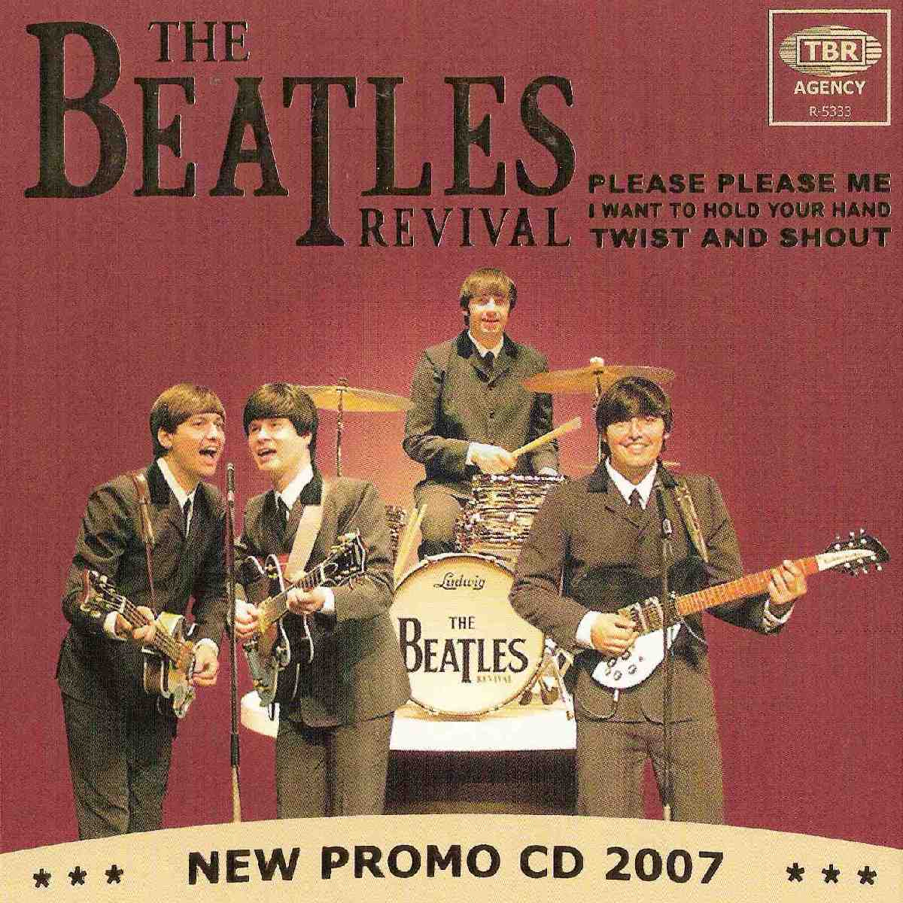
The band The Beatles
The Beatles is the most popular and influential group in history of popular music
Their songs have dominated the 1960s, when people believed that music can change the world,

Slide 10
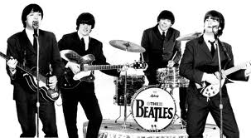
Praise The Beatles based on skill composing John Lennon and Paul McCartney
At first they both wrote the traditional rock and roll songs about friendship and love

Slide 11
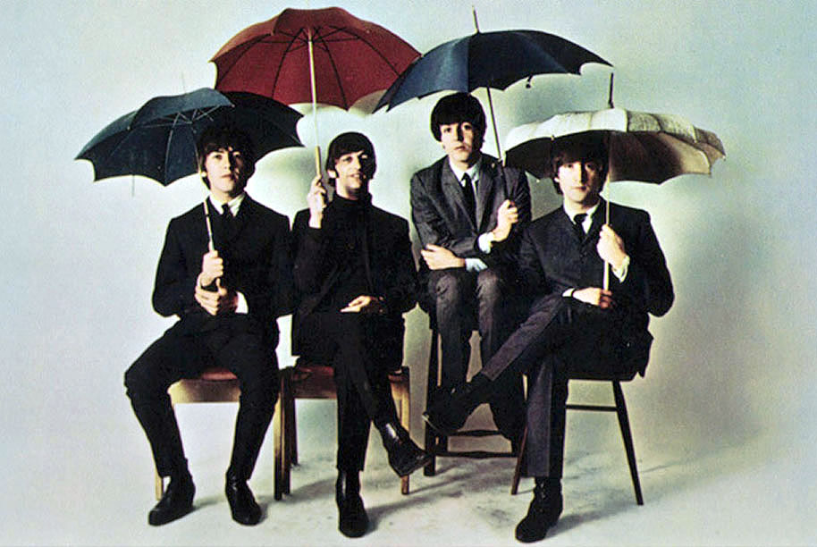
Completion of The Beatles
In 1969th the group began to disintegrate due to a conflict that grew among the four members of its
The Beatles released twelve original albums

Slide 12
The End

