Slide 1
Will Smith
ADHD

Slide 2
Family and early life
Born and raised in West Philadelphia, Pennsylvania, Smith also spent time in Germantown in Northwest Philadelphia. Later he was diagnosed with ADHD
Will Smith

Slide 3
He was raised Baptist. His parents separated when he was 13, and did not actually divorce until Smith was around 30.

Slide 4
School
It is untrue, though widely reported, that Smith turned down a scholarship to attend the Massachusetts Institute of Technology (MIT); he never applied to the school, although he was admitted to a "pre-engineering program" there. He had no intention of going to college.

Slide 5
Recording and acting career
Smith started as the MC of the hip-hop duo DJ Jazzy Jeff & The Fresh Prince, with his childhood friend Jeffrey "DJ Jazzy Jeff" Townes as turntablist and producer as well as Ready Rock C (Clarence Holmes) as the human beat box.
DJ Jazzy Jeff & The Fresh Prince
Ready Rock C
MC means Master of Ceremonies

Slide 6
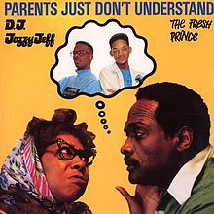
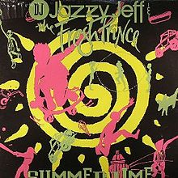
Songs
The trio was known for performing humorous, radio-friendly songs, most notably "Parents Just Don't Understand" and "Summertime".
Summertime
Parents Just Don’t Understand

Slide 7
Tax
Smith spent money freely during his early career and underpaid his income taxes. The Internal Revenue Service eventually assessed a $2.8 million tax debt against Smith, took many of his possessions, and garnished his income.

Slide 8
The Fresh Prince of Bel-Air
Smith was nearly bankrupt in 1990 when the NBC television network signed him to a contract and built a sitcom, The Fresh Prince of Bel-Air, around him. The show was successful and began his acting career.
The Fresh Prince of Bel-Air

Slide 9
A goal
Aside from his ADHD Smith set for himself the goal of becoming "the biggest movie star in the world," studying box office successes' common characteristics.

Slide 10
Breaktrough
In 1996, Smith starred as part of an ensemble cast in Roland Emmerich's Independence Day. The film was a massive blockbuster, becoming the second highest grossing film in history at the time and establishing Smith as a prime box office draw.

Slide 11
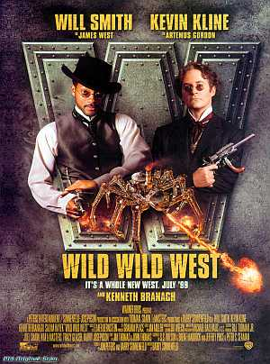
More films
In 1998, Smith starred with Gene Hackman in Enemy of the State. Smith turned down the role of Neo in The Matrix in favor of Wild Wild West.

Slide 12
Guinness book of world records
In 2005, Smith was entered into the Guinness Book of World Records for attending a record breaking three premieres in a 24-hour time span.

Slide 13
Grauman’s Chinese Theatre
On December 10, 2007, Smith was recognized at Grauman's Chinese Theatre on Hollywood Boulevard.
Smith left an imprint of his hands and feet outside the world renowned theater in front of many fans.
Smith’s imprint of hand and feet

Slide 14
I Am Legend
Later that month, Smith starred in the film I Am Legend, released December 14, 2007.
Despite marginally positive reviews, its opening was the largest ever for a film released in the United States during December.
I Am Legend

Slide 15
The Last Pharaoh
Smith is currently developing a film entitled The Last Pharaoh, in which he will star as Taharqa.
The Last Pharaoh

Slide 16
Men in Black III
He is currently filming Men in Black III for a 2012 release playing Agent J one of his more popular earlier roles, making this his first major starring role in four years.
Men in Black III

Slide 17
Personal life
Smith married actress Jada Pinkett in 1997 and practice an open marriage. Together they have had two children:
Jaden Christopher Syre , his co-star in The Pursuit of Happyness,
Willow Camille Reign, who appeared as his daughter in I Am Legend.
Willow and Jaden Smith

Slide 18
Company
Along with his brother, Harry Smith, he owns Treyball Development Inc., a Beverly Hills-based company named after his first son.

Slide 19
Nobel Prize
Smith was consistently listed in Fortune Magazine's "Richest 40" list of the forty wealthiest Americans under the age of 40. He donated $4,600 to the presidential campaign of Democrat Barack Obama. December 11, 2009, Smith and his wife hosted the Nobel Peace Prize Concert in Oslo, Norway, when Obama had won the prize.
Smith and his family

Slide 20
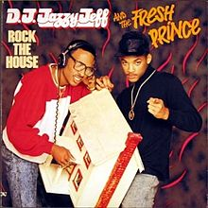
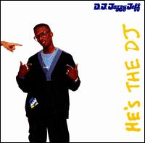
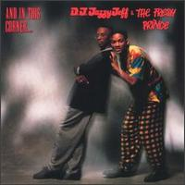
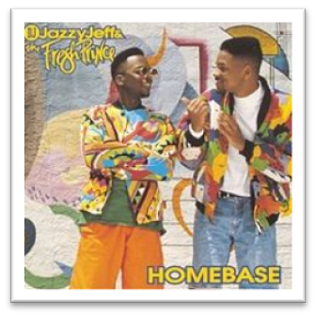
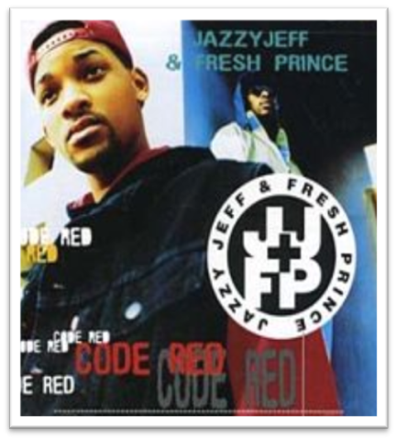
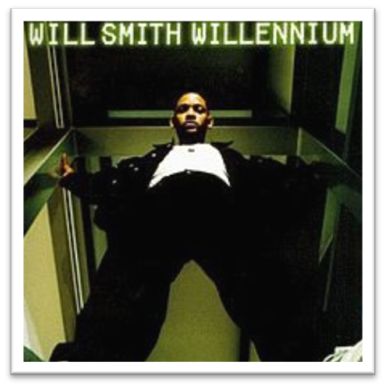
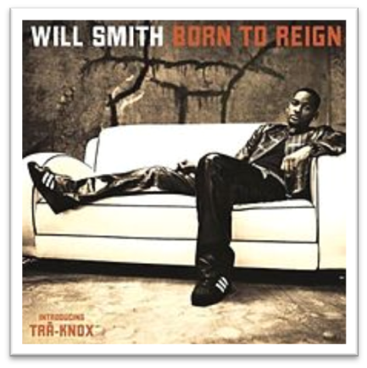
Discography
Rock The House
He's the DJ, I'm the Rapper
And in This Corner...

Slide 21
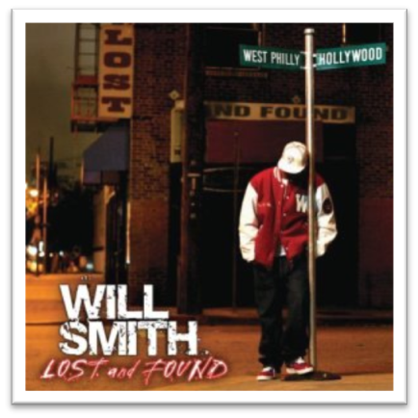

Slide 22
Conclusion
What can we conclude from this ?
That ADHD people are successful. And they became successful with their hard work and if they can do it you can do it too.

Slide 23
Questions
Where was Smith born?
What was the name of the duo with Smith and his childhood friend?
What was name of the show that Smith was acting?
Name some of the films that Smith was acting.
What are the names of Smith’s children?
Name one album of his duo.

Slide 24
